Slide 1

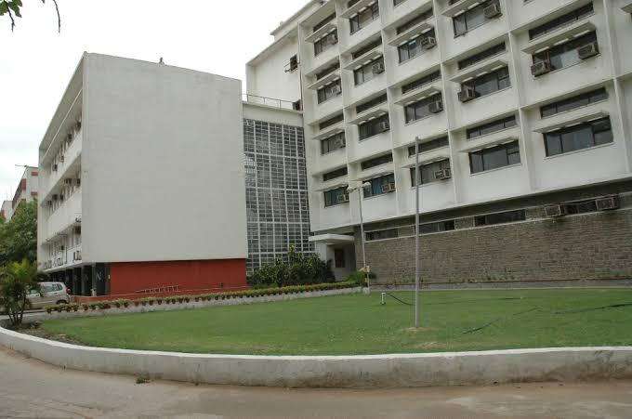
School of Planning and Architecture
DELHI
SPA Delhi is a premier institution in India, offering undergraduate and postgraduate courses in the field of planning and architecture. Established in 1941, it has a long and illustrious history of producing some of the best architects and planners in the country. SPA Delhi is known for its rigorous academic curriculum and its focus on promoting sustainable and socially responsible design. The campus is equipped with state-of-the-art facilities, including design studios, workshops, and a well-stocked library, providing students with an ideal learning environment.

Slide 2
Courses
Bachelor of Architecture (B.Arch.)
Bachelor of Planning (B.Plan.)
Master of Architecture (M.Arch.)
Master of Planning (M.Plan.)
Master of Urban Design (M.U.D.)
Master of Design (M.Des.)
Master of Building Engineering and Management (MBEM)

